Slide 1
FITYNTRA
Health
Fitness
Nutrition
FITYNTRA
स्वस्थ शरीर, सशक्त जीवन
An Adaptive AIML-Driven Fitness and Nutrition Platform with Injury-Aware Wellness Support
Integrating Personalized Health, Indian Diets & Clinical Safety
COHORD 23

Slide 2

FITYNTRA
INTRODUCTION
Maintaining sustainable fitness and nutrition is complex due to non-linear biometrics and regional dietary habits. Existing apps rely on static formulas, ignoring stress, sleep, macronutrients, and injuries. Advances in ML and NLP now enable dynamic personalized guidance. FITYNTRA integrates Indian dietary data with clinical guardrails for safe, adaptive wellness.

Slide 3
FITYNTRA
PROBLEM STATEMENT
Current fitness and nutrition applications face critical limitations that compromise user safety and effectiveness. These systemic issues particularly impact users with specific dietary needs, medical conditions, or those seeking holistic wellness guidance.
Apps hallucinate macros, ignore Indian diets.
No injury-aware guidance risks physical harm.
Data leakage causes inaccurate predictions.
Underuse of multi-agent AI for holistic care.

Slide 4

FITYNTRA
OBJECTIVES
Develop a Culturally Relevant Diet Engine
Ensure Clinical Safety through AI
Optimize Predictive Accuracy
Promote Long-Term Engagement
Deliver a Production-Ready Application
FastAPI backend & React frontend

Slide 5



FITYNTRA
AI-Powered Personalization
AI personalizes dietary and fitness recommendations based on individual profiles; ML models guide healthier food choices.
LITERATURE SURVEY
Indian-Focused AI Systems
Local food recognition systems estimate calories for Indian diets using wearable data for physiological metrics.
AI and ML research demonstrates powerful capabilities for personalized health guidance and nutrition optimization.
Nutrition in Injury Recovery
Research highlights nutrition's critical role in recovery: anti-inflammatory nutrients, proteins, and vitamins accelerate healing.

Slide 6

FITYNTRA
METHODOLOGY
Core data, tools, and process used for FITYNTRA's AI-driven system development.
Tools
Process
Datasets
Python, Scikit-Learn, XGBoost for ML models. FastAPI backend, React.js frontend. Anthropic Claude 3.5 and groq's llama 3.3 for NLP virtual coaching capabilities.
Data cleaning, normalization, clinical keyword extraction via Regex. ML model upgrade from Random Forest to XGBoost with Filter-and-Rank to avoid data leakage. Multi-agent NLP pipeline for injury classification.
ICMR-NIN Indian nutrition database, Physiopedia rehab protocols, synthesized user biometrics data.

Slide 7
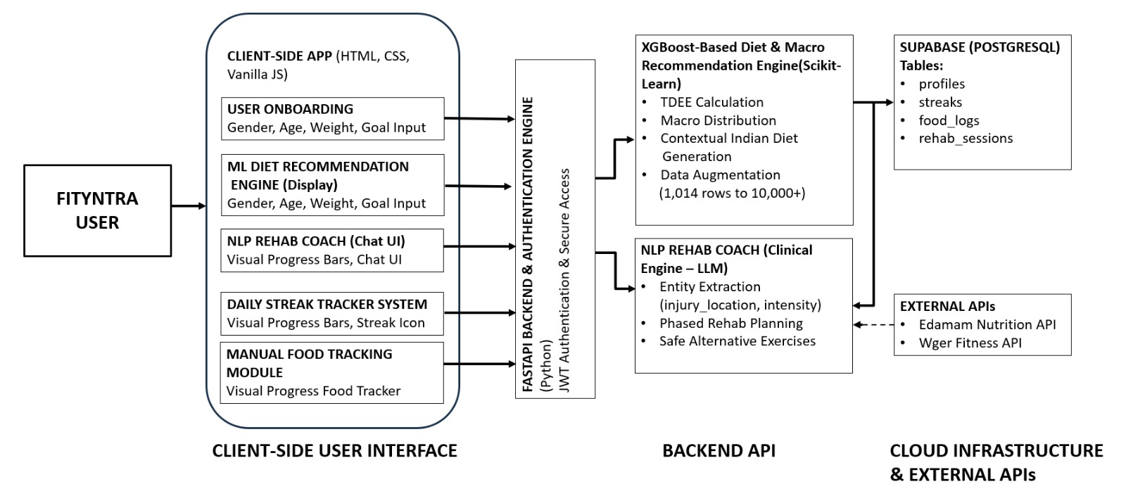
FITYNTRA
SYSTEM ARCHITECTURE

Slide 8
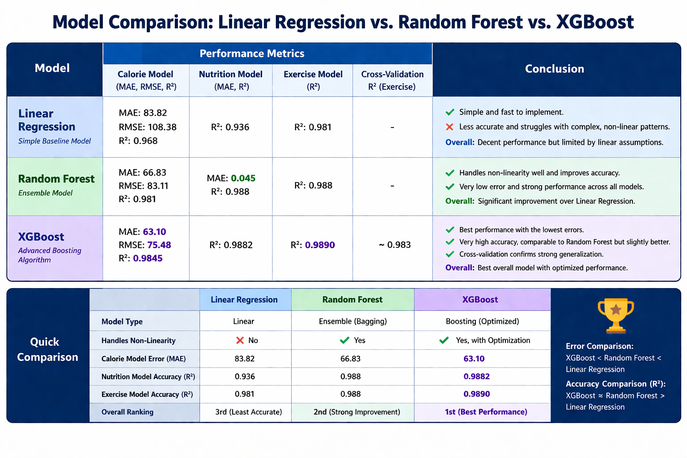
ML MODELLING RESULTS
FITYNTRA

Slide 9
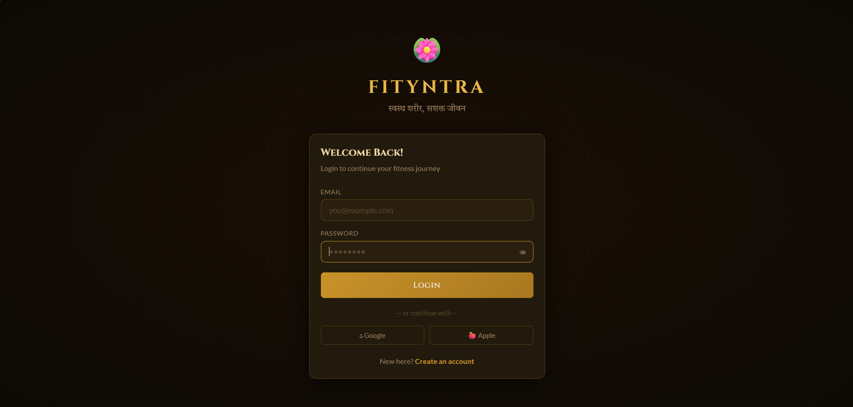
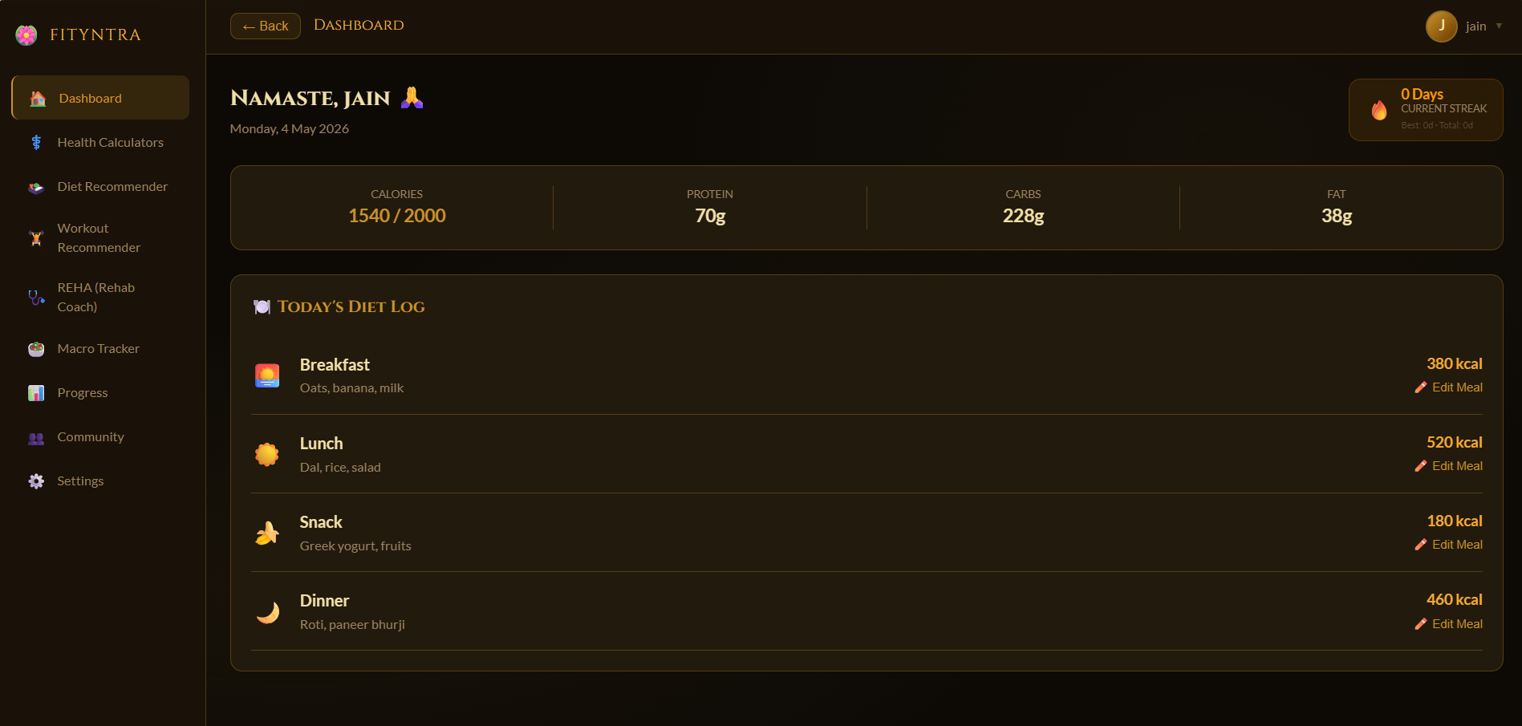
FITYNTRA
RESULTS &OUTCOMES
Fig 1: Login page
Fig 2: Dashboard

Slide 10
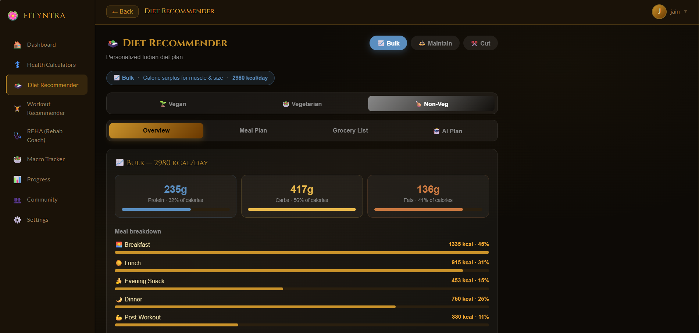
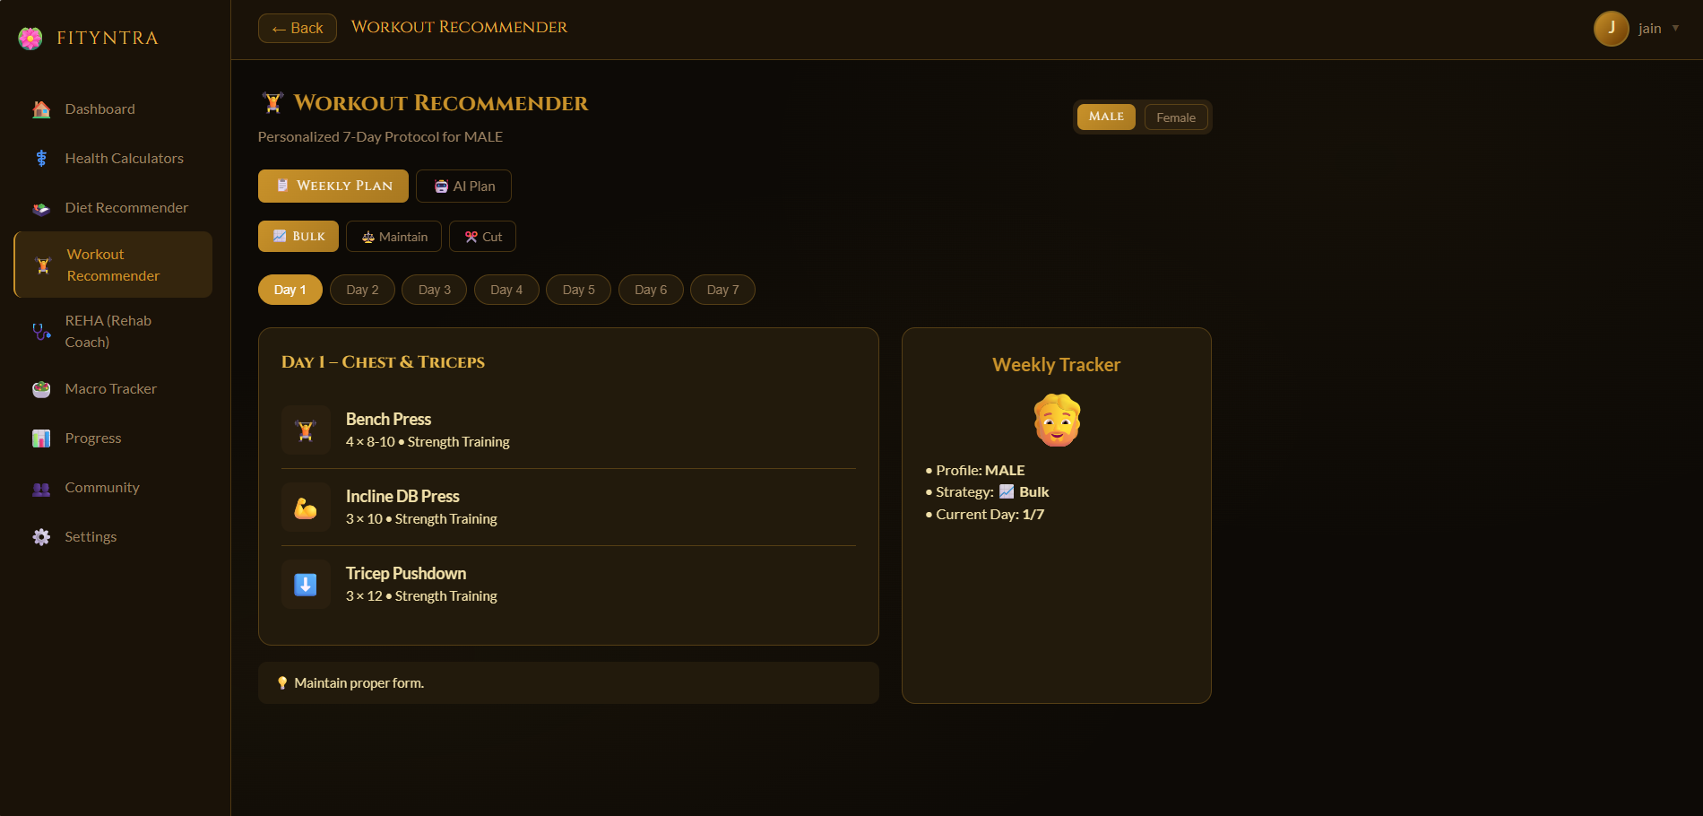
FITYNTRA
RESULTS &OUTCOMES
Fig 3: Diet Recommender page
Fig 4: Workout Recommender page

Slide 11
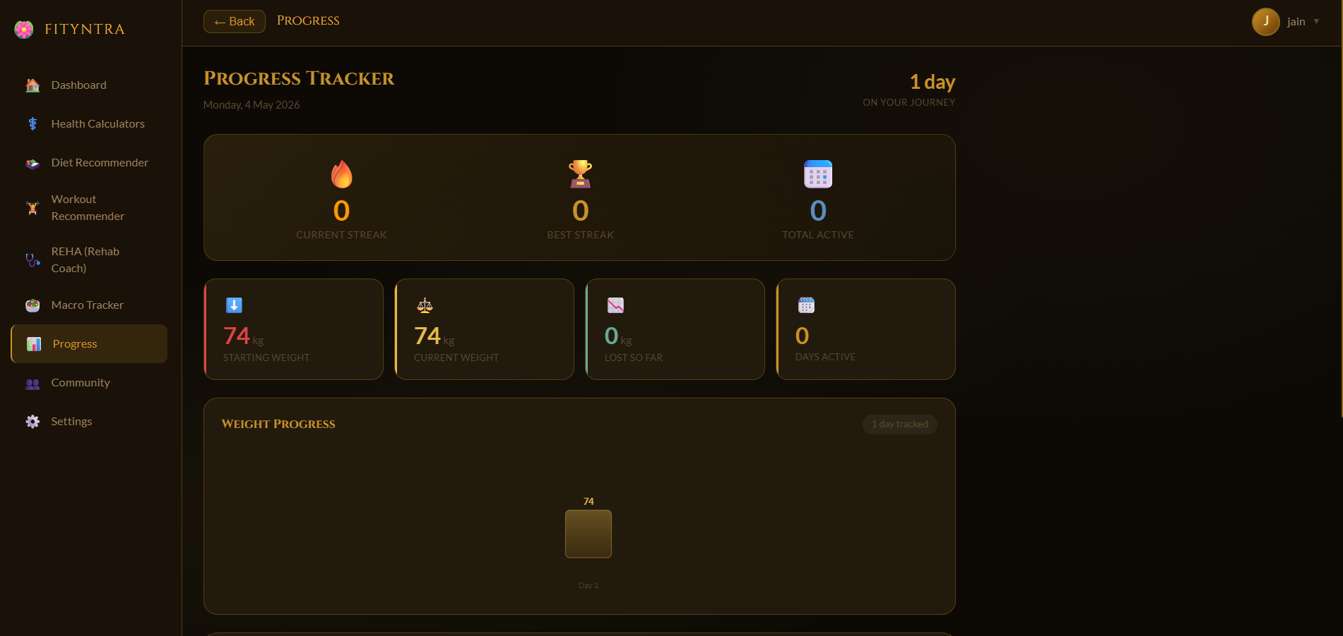
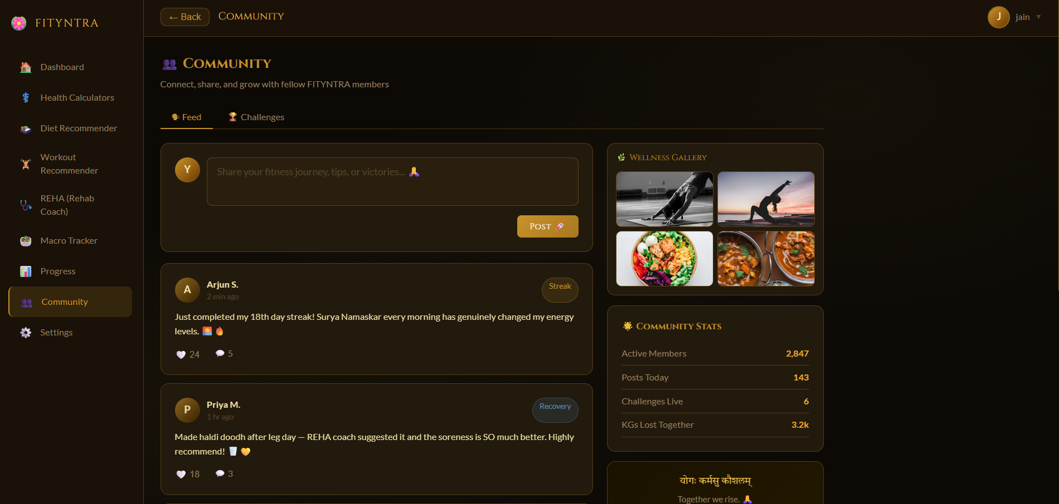
FITYNTRA
RESULTS &OUTCOMES
Fig 5: Progress Tracker page
Fig 6: Community page

Slide 12
FITYNTRA
References
Sources
9/9
KEY REFERENCES
[1] S. Bhandari, S. G. Bansal, S. Santhosh, and I. P. Lakhekar, "AI-Powered Fitness and Diet Recommendation System: A Personalized Approach to Health and Wellness," International Research Journal on Advanced Engineering and Management, vol. 3, no. 3, pp. 534–539, Mar. 2025. [Online].
[2] J. Chen and Y. Wang, "Personalized fitness recommendations using machine learning for optimized national health strategy," Scientific Reports, vol. 15, Feb. 2025. [Online].
[3] H. M. Gaikwad, T. Sakshi, P. Siddhi, K. Vaishnavi, and R. Shravani, "CalorieScan: AI-Powered Food Recognition and Calorie Estimation System for Indian Diets," International Journal of Advanced Research in Computer and Communication Engineering, vol. 15, no. 3, p. 220, Mar. 2026. [Online].
[4] A. A. Gedi, A. A. Khalif, M. A. S. Doon, A. A. Mohamed, I. A. Ali, and B. A. Ahmed, "Personalized Gym Recommendation System Using Machine Learning,"International Journal of Engineering Trends and Technology, vol. 73, no. 4, pp. 249–257,Apr. 2025.
[5] S. Ghosh, D. Ghosh, and A. Chakraborty, "Nutrition for Recovery of Sports Injury," in The Biochemical Aspects of Sports Nutrition, KDPublications, pp. 1–10. [Online].
[6] S. Hussain, N. Khan, S. A. A. Shah, S. Bano, and A. W. Khan, "AI-Driven Personalized Meal Planning: A Web-based Platform for Tailored Nutrition and Health Management," International Journal of Computer Applications, vol. 187, no. 57, p. 17, Nov. 2025.
[7] Z. Jiang et al., "DietGlance: Dietary Monitoring and Personalized Analysis at a Glance with Knowledge-Empowered AI Assistant," arXiv preprint arXiv:2502.01317, Feb. 2025. [Online].
[8] H. Kayange, J. Mun, Y. Park, J. Choi, and J. Choi, "A Hybrid Approach to Modeling Heart Rate Response for Personalized Fitness Recommendations Using Wearable Data," Electronics, vol. 13, no. 19, p. 3888, Sep. 2024. [Online].
[9] M. Shaheel, "Diet Recommendation System Using Machine Learning," Bournemouth University, Dec. 2023. [Online].
[10] X. Wang, Z. Sun, H. Xue, and R. An, "Artificial Intelligence Applications to Personalized Dietary Recommendations: A Systematic Review," Healthcare, vol. 13, no. 12, p. 1417, Jun. 2025. [Online].

Slide 13
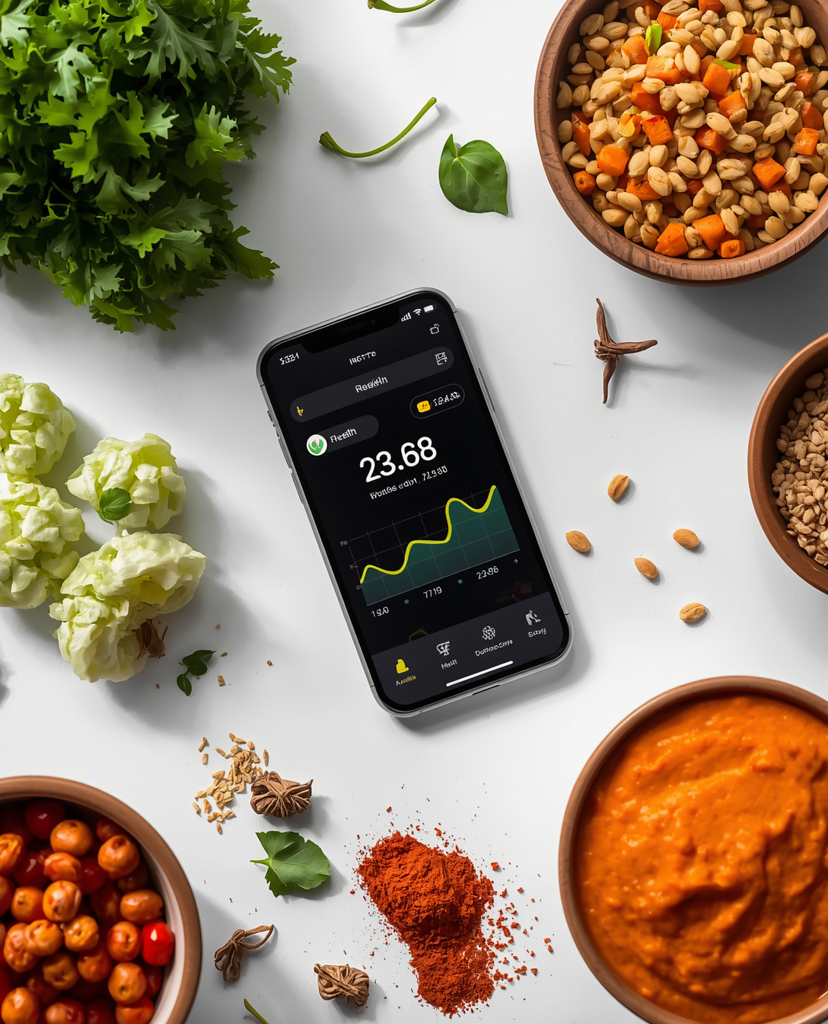
FITYNTRA
THANK YOU
Questions?

